Slide 1



Explainable Models for Healthcare AI
Ankur Teredesai
Muhammad Aurangzeb Ahmad
Carly Eckert M.D.
Vikas Kumar
KenSci Inc. + University of Washington Tacoma
https://www.kensci.com/explainable-machine-learning/

Slide 2




Explainable Models in AI
© KenSci., Inc. 2018.

Slide 3
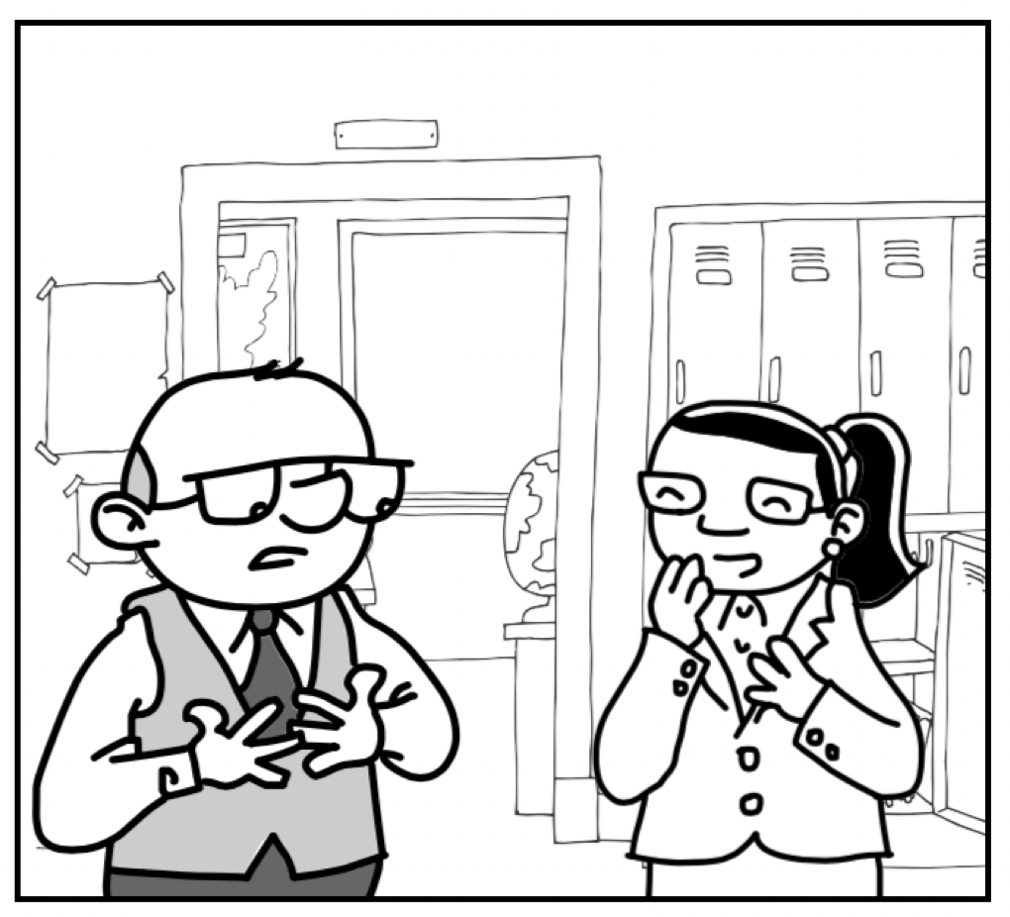
Doctor, are you sure that I am ok now? My head still hurts.
Well, the computer assures me that you are fine and it has given me 100 reasons for it.
© KenSci., Inc. 2018.

Slide 4

Learning Objectives of the Tutorial
Why ?
The AI & ML needs to provide explanations in Healthcare.
What ?
Type of Explanations do we need in Healthcare
How ?
To select the right machine learning algorithms when explanations are needed
Where ?
Settings and different types of interpretable machine learning models
When?
The past the present and the future of explainable AI in healthcare
© KenSci., Inc. 2018.

Slide 5

Explainable By Any other Name.. is still explainable
Explain: Make (an idea or situation) clear to someone by describing it in more detail or revealing relevant facts.
Interpret: Explain the meaning of (information or actions)
Understand: Perceive the intended meaning of (words, a language, or a speaker)
Comprehend: Grasp mentally; understand
Intelligible: Able to be understood; comprehensible [Dictionary, Oxford English 2018]
© KenSci., Inc. 2018.

Slide 6
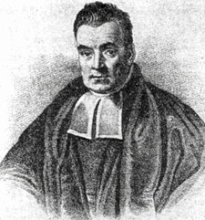

A (Brief) History of Need for Explainations in Statistics
Foundations of Logic: Clear and explicit reasoning, explainable to almost anyone
Bayes: Grounding Probability and inference on solid foundations (18th century) [Bayes 1763]
Goal of (early) AI: Mimic human reasoning mechanically
Early Expert Systems in healthcare like MYCIN were explainable systems
Push around explainability when ensemble methods first came about in the 1980s
Current interest in explainability is because of widespread adoption and deployment of machine learning systems
© KenSci., Inc. 2018.
Source: Wikipedia

Slide 7
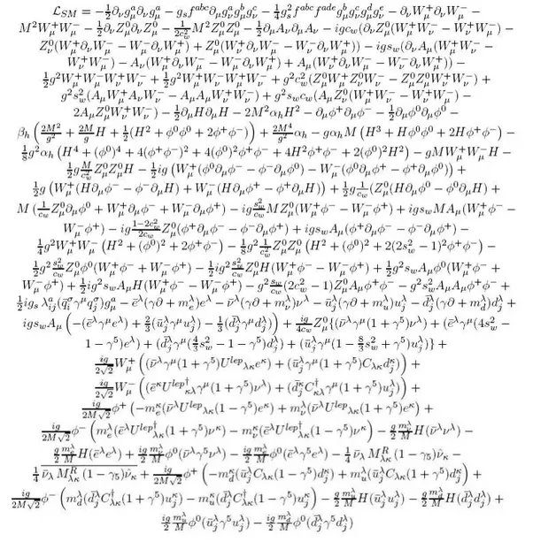
Explainable AI / Interpretable Machine Learning
Explanations of AI/machine learning models to humans with domain knowledge [Craik 1967, Doshi-Velez 2014]
Why is the prediction being made?
Comprehensible to humans in (i) natural language (ii) easy to understand representations
Standard Model Lagrangian
© KenSci., Inc. 2018.

Slide 8

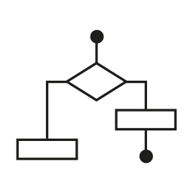




Explainable AI is More Than Models
AI Solution
User
Cognitive Capacity
Features
Algorithm
Model Parameters
Model
Each element constituent of the solution process needs to be explainable for the solution to be truly explainable [Lipton 2016]
Domain Knowledge
© KenSci., Inc. 2018.
Explanation Granularity

Slide 9
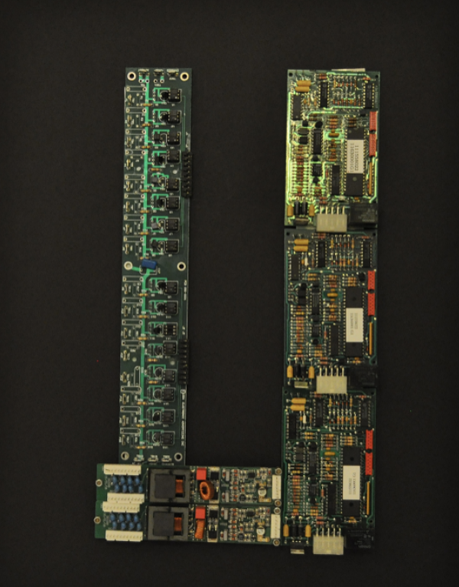
What Explanations Are Not?
Explanation vs. Justification
Explaining is giving reasons for the prediction [Biran 2014, Biran 2017A, Biran 2017B]
Justification is putting the explanation in a context
Justification does not have to correspond to how the model actually works
Explanation vs. Causality
Explanations are mostly:
Not Causal
Not Prescriptive
Example: End of life prediction for heart failure patients
© KenSci., Inc. 2018.
Source: www.aurumahmad.com

Slide 10
Healthcare AI
© KenSci., Inc. 2018.

Slide 11

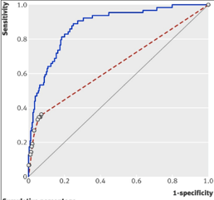

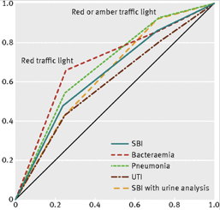

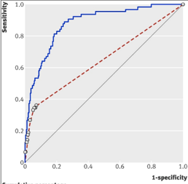
How Are Decisions Made in Healthcare?
1. Heuristics
Factors: 7 ± 2
~80% Care Decisions
2. Rules based system
Factors: 10s
~18% Care Decisions
3. ML based System
Factors: 100s
~2% Care Decisions
© KenSci., Inc. 2018.
Notes:
http://bmjopen.bmj.com/content/5/8/e008657.full

Slide 12
How Machine Learning Can Improve Healthcare Across the Continuum of Care?
Birth
CHF
Healthcare Utilization
Appendicitis
Colds, minor injuries
Preventive care
Birth of two children
Diabetes
Death
0
10
20
30
40
50
60
70
80
Age (years)
Optimize hospital efficiency
Optimize clinic operations and benefit to patient
Prevent sequelae of disease
Improve operations and diagnose illness sooner
Prevent post operative complications
Chronic disease management (CHF)
Help patient plan for end of life needs
Optimize inpatient flow
Chronic disease management (DM)
Care management RecSys
Variation analysis
No show prediction
Predict disease progression
EOL prediction
Rx noncompliance prediction
LOS prediction
ROR prediction
Predict disease complications
ED flow suite
SSI prediction
Other predictions
EF Progression prediction
© KenSci., Inc. 2018.

Slide 13
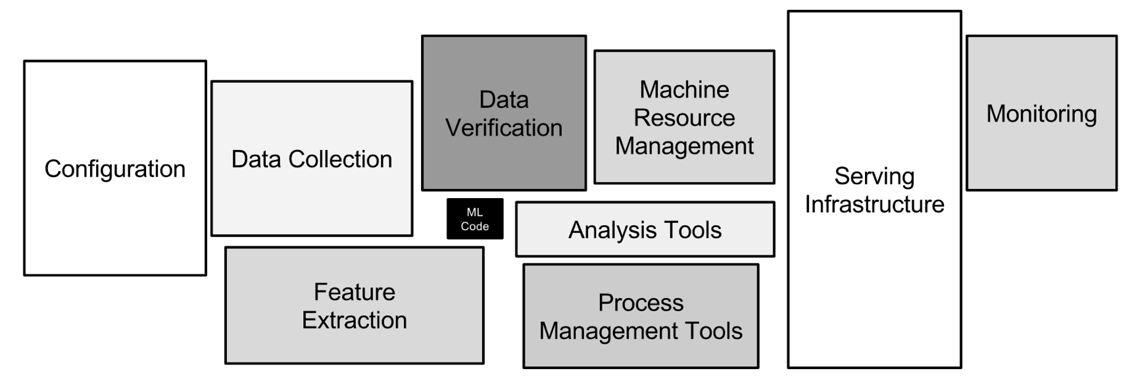
Operationalizing AI in Healthcare
Only a small fraction of real-world machine learning systems actually constitutes machine learning code [Sculley 2015].

Slide 14
Data Complexity in Operationalizing AI in Healthcare
Syntactic Correctness
Is the data in the correct format e.g., if the AI data pipeline requires sex for males as ‘m’ and the input data encodes it as ‘1’
Morphological Correctness
Is the data within the range of possible values e.g., a blood pressure of 500 does not make sense
Semantic Correctness
Do the variables actually correspond to what the semantics that are being ascribed to them e.g., a variable which encodes blood pressure as high vs. low will have different semantics for children as compared to adults
© KenSci., Inc. 2018.

Slide 15
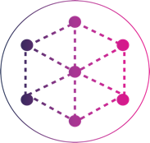
Why Do We Need Explanations in Healthcare AI Now?
More Implications (known/unknown)
More Data
More AI
© KenSci., Inc. 2018.

Slide 16
Do We ALWAYS Need Explanations in Healthcare AI?
When fairness is critical:
Any context where humans are required to provide explanations so that people cannot hide behind machine learning models [Al-Shedivat 2017B, Doshi-Velez 2014]
When consequences are far-reaching:
Predictions can have far reaching consequences e.g., recommend an operation, recommend sending a patient to hospice etc.
When the cost of a mistake is high:
Ex: misclassification of a malignant tumor can be costly and dangerous
When a new/unknown hypothesis is drawn:
“It's not a human move. I've never seen a human play this move.” [Fan Hui]
Pneumonia patients with asthma had lower risk of dying [Caruana 2015]
Compliance is key:
GDPR
Right to Explanation
Predictive performance is not enough
[Doshi-Velez 2017]
© KenSci., Inc. 2018.

Slide 17
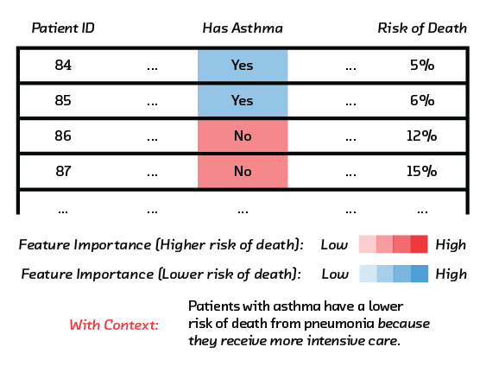
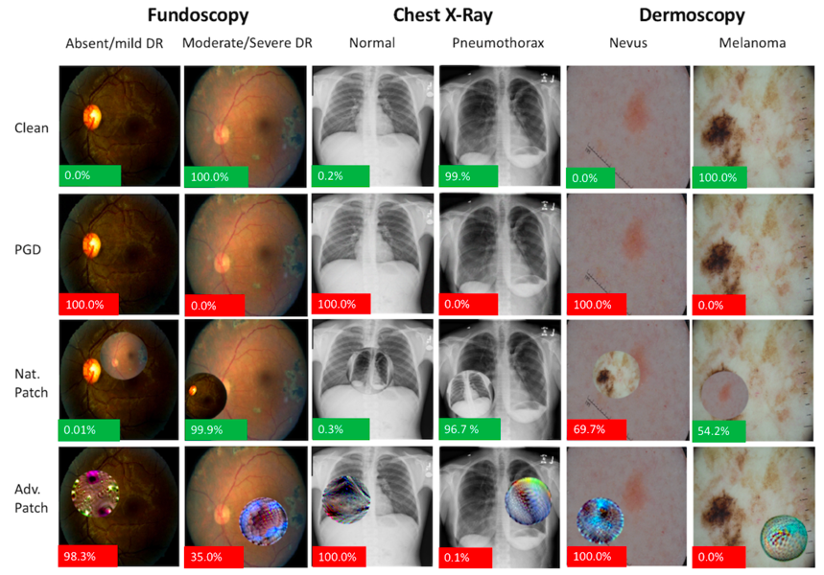
Why Do We Need Explanations Now?
Risk Prediction with Blackbox Models
Misdiagnosis via Adversarial Attacks
[Caruana 2015, Caruana 2017]
[Finlayson 2018]

Slide 18
Pillars of Explainable AI
© KenSci., Inc. 2018.

Slide 19
7 Pillars of Explainable AI in Healthcare
Transparency
Domain Sense
Consistency
Parsimony
Generalizability
Trust/
Performance
Fidelity
© KenSci., Inc. 2018.

Slide 20
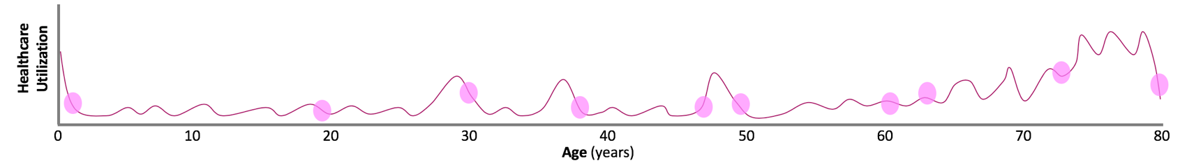
Pillar 1: Transparency | Admission Prediction
Transparency
Ability of the machine learning algorithm, model, and the features to be understandable by the user of the system.
Katherine presents to the emergency department with severe headaches. She has multiple episodes of vomiting.
She is evaluated by the clinical staff and has imaging and laboratory work done. She has very little medical history and considers herself active and healthy.
Admission Prediction
What is the likelihood of the patient being admitted to the hospital from the emergency department.
© KenSci., Inc. 2018.
Notes:
Emergency departments evaluate and manage hundreds of patients each day. Busy EDs are the norm around the world. The pressure is on ED physicians and administrators to quickly make decisions regarding patient treatment and disposition
ML algorithms can assist providers in

Slide 21

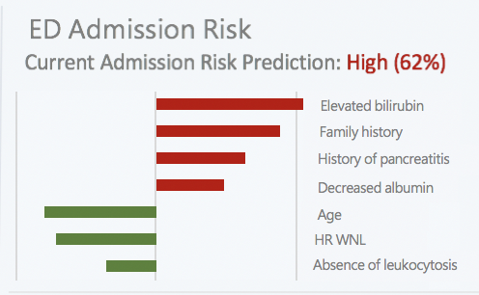
Transparency
The ML model for predicting Katherine’s likelihood of admission gives her a low likelihood (0.32)
Katherine’s physician has noted her age, health history, and vital signs and is reassured by her relatively low risk score
The physician knows that the risk model is a deep learning model so he cannot understand how it is working
But, he can examines the top factors associated with prediction
Low 32%
Heart rate
Creatinine
Family history
No PCP
Age
Albumin WNL
Absence of leukocytosis
© KenSci., Inc. 2018.
Notes:
Visual with EHR based patient care, 62% risk score and associated factors

Slide 22
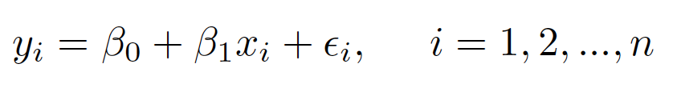
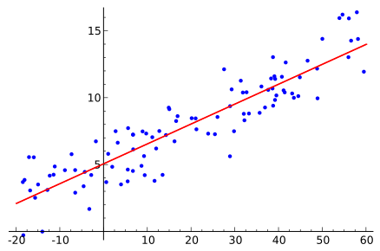
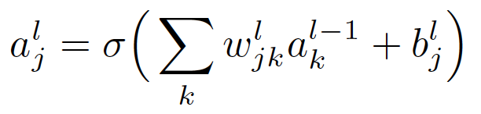
Transparent to Whom?
Transparency may mean different things to different people
Understanding Model Outputs:
Understanding Algorithms:
Understanding the algorithm may not mean be sufficient:
© KenSci., Inc. 2018.

Slide 23
Transparency | Examples
Transparent
Falling Rule Lists
GAM (Generalized Additive Models)
GA2M (Generalized Additive Models with interactions)
LIME (Locally Interpretable Model Agnostic Explanations)
Naïve Bayes
Regression Models
Shapley Values
Semi-Transparent
Shallow Ensembles
Non-Transparent
Deep Learning
SVM (Support Vector Machines)
Gradient Boosting Models
© KenSci., Inc. 2018.

Slide 24
Pillar 2: Domain Sense | ED Census Prediction
Domain Sense
The explanation should make sense in the domain of application and to the user of the system
Several years later, Katherine revisits the emergency department due to abdominal pain. She has an elevated temperature and is dehydrated.
She is at the ED on a Friday after work. The ED is very crowded and she must wait several hours to be seen.
ED Census Prediction
Predict the number of patients in the emergency department (ED) at a given time
© KenSci., Inc. 2018.

Slide 25
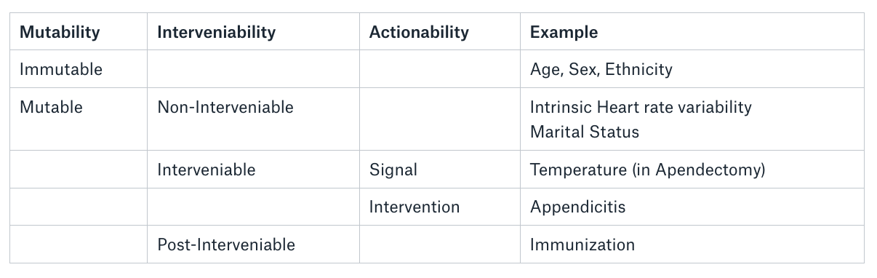
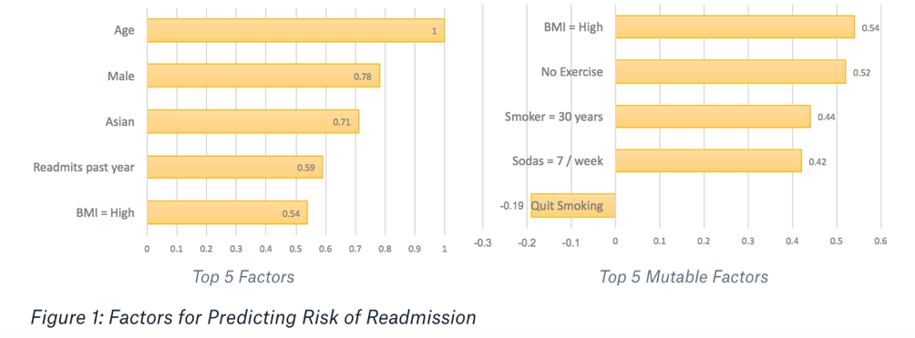
Domain Sense | Model Output & Actionability
Making Sense of Model Output
Interpreting output from machine learning models may also has an element of subjectivity
Example: If a patient has a readmission risk score 0.62, what does that mean?
Actionability
Actionability does not presume causality but can be used to devise interventions
Actionability is temporal e.g., flu vaccine administration is a 1 minute task vs. weight loss programs which can take months
© KenSci., Inc. 2018.

Slide 26
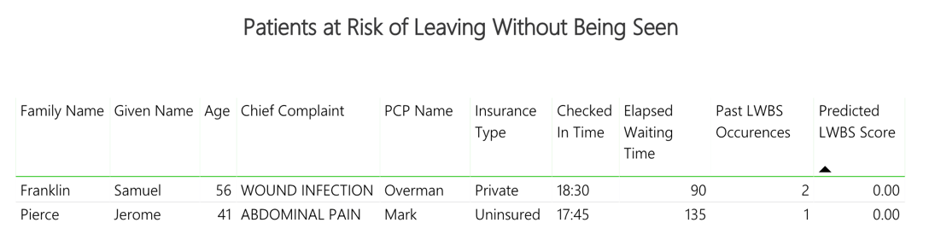
Pillar 3: Consistency | LWBS
Consistency
The explanation should be consistent across different models and across different runs of the model
~18:00
Factors
Prior LWBS
Insurance status
Past history
62
40
Collins Katherine 37 ABDOMINAL PAIN Monroe Private 16:52 68 0 24
LWBS
Left without being seen refers to a patient leaving the facility without being seen by a physician
~22:00
Factors
Temperature
Insurance status
Chief complaint
Age
62
40
Collins Katherine 37 ABDOMINAL PAIN Monroe Private 16:52 314 0 24
Kennedy Susan 72 DYSPNEA Lewis Medicare 19:45 135 1 60
© KenSci., Inc. 2018.

Slide 27
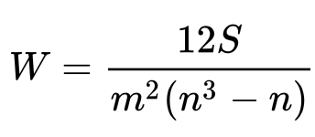
Consistency | Model Multiplicity
Given the same dataset, multiple machine learning algorithms can be constructed with similar performance
The explanations from multiple explainable algorithms should be very similar
Divergent Explanations symptomatic of problem with explanations and/or algorithm(s)
Evaluation:
Human Evaluation: Expert Agreement
Machine Evaluation: Ranked List Comparison
Variable | Model A | Model B | Model C
Age | 1 | 1 | 5
Gender | 2 | 4 | 6
Diabetic | 3 | 5 | 1
Race | 4 | 6 | 4
Smoker | 5 | 2 | 3
Alcoholic | 6 | 3 | 2
Variables for Length of Stay Prediction Ranked
Kendall’s W: [Kendall 1939]
© KenSci., Inc. 2018.

Slide 28
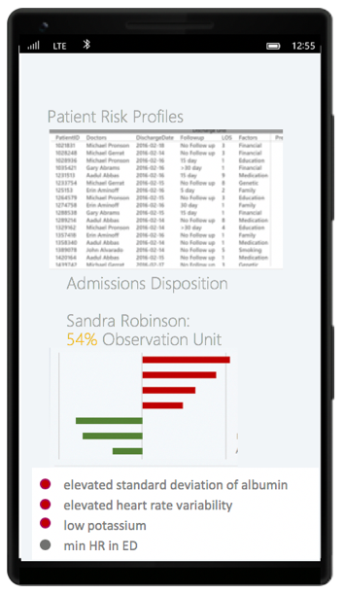
Pillar 4: Parsimony| Admission Disposition
Parsimony
The explanation should be as simple as possible
Applies to both the complexity of the explanation and the number of features provided to explain
Admission Disposition
Where in the hospital the patient should go once they are admitted
Katherine Clay
© KenSci., Inc. 2018.

Slide 29

Parsimony
MDL (Minimum Description Length) and Occam’s Razor
Occam’s Razor: To derive a unifying diagnosis that can explain all of a patient’s symptoms
Hickam’s Dictum: A man can have as many diseases as he damn well pleases
Occam’s Razor in Machine Learning [Domingos 1999]
Occam’s First Razor
Occam’s Second Razor
The simplest explanation is not always the best explanation
© KenSci., Inc. 2018.

Slide 30
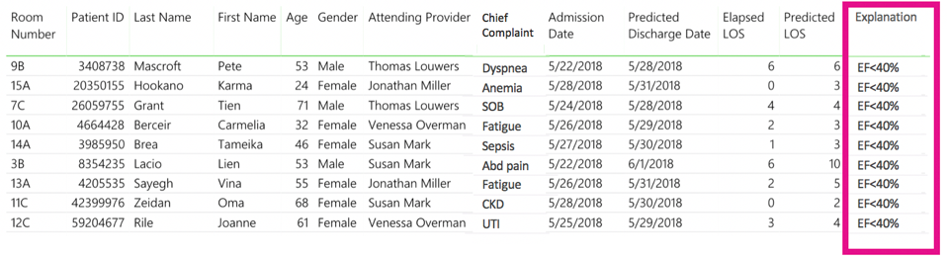
Pillar 5: Generalizability | Length of Stay Prediction
Generalizability
Models and explanations should be generalizable across problem whenever possible
Katherine eventually develops diabetes. It is well controlled and she takes her medications as directed. One afternoon, she is admitted from clinic due to highly elevated glucose levels and a urinary tract infection. Her nurse tells her that based on her illness and other factors, her predicted length of stay is 3 days.
Length of Stay
The time that a patient will spend at a particular healthcare facility
Diabetes
Diabetes
Diabetes
Diabetes
Diabetes
Diabetes
Diabetes
Diabetes
Diabetes
© KenSci., Inc. 2018.

Slide 31
Pillar 5: Generalizability | Length of Stay Prediction
Model Generalizability
Local Models: Models that give explanations at the level of an instance e.g., LIME, Shapley Values etc.
Cohort Level Models: A type of global models where the explanations are generated at the level of cohort
Global Models: Models that give explanations e.g., Decision Trees, Rule Based Models etc.
Algorithm Generalizability
Model Agnostic Explanations:
Examples: LIME, Shapley Values etc.
Model Class Specific Explanations:
Examples: Tree Explainers, Gradient Boost Explainers
Model Specific Explanations:
Examples: CENs, Decision Trees, Random Forest Explainer etc.
© KenSci., Inc. 2018.

Slide 32

Pillar 6: Trust/Performance | ICU Transfer Prediction
Trust / Performance
The expectation that the corresponding predictive algorithm for explanations should have a certain performance
ICU Transfer Prediction
Predict if a patient on the hospital ward will require transfer to the intensive care unit due to increasing acuity of care needs
Katherine Clay, Rm 436
© KenSci., Inc. 2018.

Slide 33
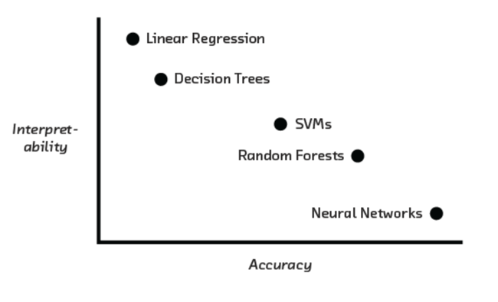
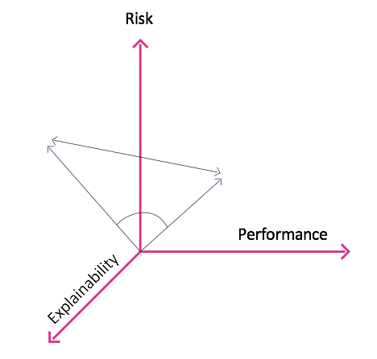
Trust | Prediction Performance
Expectation that the predictive system has a sufficiently high performance e.g., precision, recall, AUC etc. [Lipton 2016, Hill 2018]
Explanations accompanied with sub-par predictions can foster distrust
The model should perform sufficiently well on the prediction task in its intended use
The model has at least parity with the performance of human practitioners
Trauma patients: vital signs and lab criteria fulfill criteria to trigger alarm, leads to increasing numbers of false positives [Nguyen 2014]
© KenSci., Inc. 2018.

Slide 34
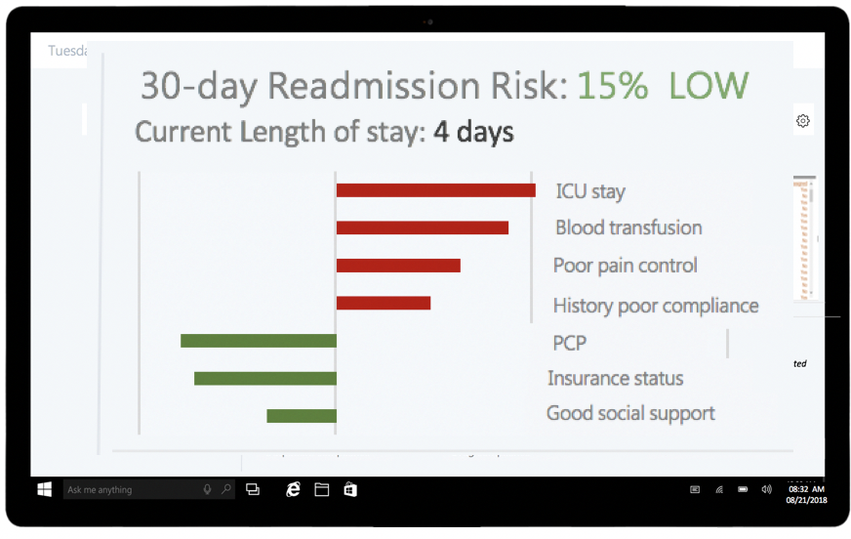
Pillar 7: Fidelity| Risk of Readmission
Fidelity
The expectation that the explanation and the predictive model align well with one another
Risk of Readmission
Predict if the patient will be readmitted within a particular span in time, i.e. 30 days from time of discharge
© KenSci., Inc. 2018.

Slide 35

Fidelity | Explanations
An explanation is Sound if it adheres to how the model actually works
An explanation is Complete if it encompasses the complete extent of the model
Ante-Hoc: Models where the predictive model and the explanation model is the same
Post-Hoc Models: Models where the predictive model and the explanation model are different
Special Case: Mimic Models
Example: Readmission model which uses lunar cycles as a feature
© KenSci., Inc. 2018.

Slide 36
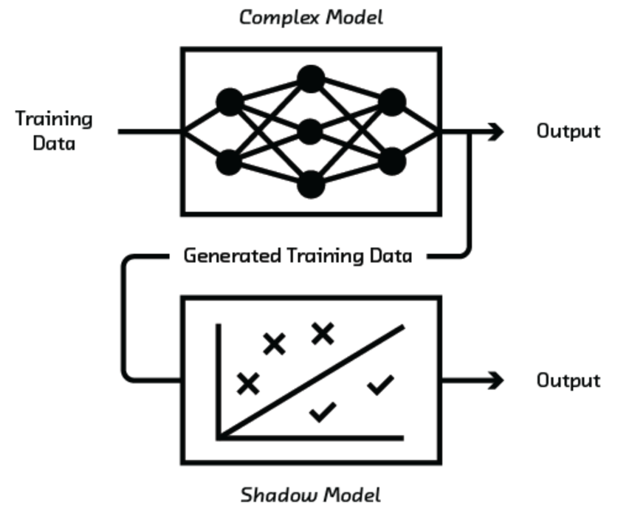
Fidelity | Mimic Models
Also known as Shadow, Surrogate or Student Models
Use the output (instead of the true labels) from the complex model and the training data to train an model which is explainable [Bucilua 2006, Tan 2017]
The performance of the student model is usually quite good
Example: Given a highly accurate SVM, train a decision tree on the predicted label of the SVM and the original data
© KenSci., Inc. 2018.

Slide 37



Conclusion: Explainable ML in Healthcare AI
+
Explanations
Artificial Intelligence
Assistive Intelligence
Clinical Expertise
© KenSci., Inc. 2018.

Slide 38
References
© KenSci., Inc. 2018.

Slide 39
References
© KenSci., Inc. 2018.

Slide 40
References
© KenSci., Inc. 2018.

